Slide 1
ANL201 – Study Units
Time frame and Deliverables
Study Unit | Topic | Date (2022) | Quiz | Deadlines
1 | Business Performance Management Balanced Scorecard Strategy Map | 05th Feb | Pre-Course Quiz 01* | 24th Jan – 4th Feb
2 | All about Data | 10th Feb | Pre-Class Quiz 01* | 7th Feb – 14th Feb
 |  |  | Tutor Marked Assignment | 16th Feb (by 2355 hrs)
3 | Theory/ Foundation to Visualization | 17th Feb | Pre-Class Quiz 02* - | 21st Feb – 28th Mar -
4 | Basic Visualization | 24th Feb
5 | Advanced Visualization | 3rd Mar | Group Based Assignment | 2nd Mar (by 2355 hrs)
6 | Business Performance Dashboard | 10th Mar | End of Course Assessment | 17th Mar (by noon)
*All quizzes have a 12-NOON deadline. No extensions!

Slide 2
Learning Objectives of ANL201
By the end of this Course
Understand concepts of Business Performance, Measurement, Balanced Scorecard Model and Data Visualization
Compare stages of Data Visualization Process
Data Visualization Components
Design Principles of a Business Performance Dashboard
Appropriateness of Data Visualization techniques based on available data
Appropriates of Business Performance Measure against Business Strategy of Organization
Required Textbooks:
Yau, N,.(2013). Data Points: Visualization that Means Something
Murray, D. G. (2013). Tableau Your Data

Slide 3
Visualisation for Business ANL 201
The Science of Data Visualisation Study Unit 2
January 2022

Slide 4
Data Visualisation

Slide 5
Data Visualisation
The big idea – Concepts
Data — facts and statistics used for reference or analysis
Data Visualisation — the graphical representation of data

Slide 6
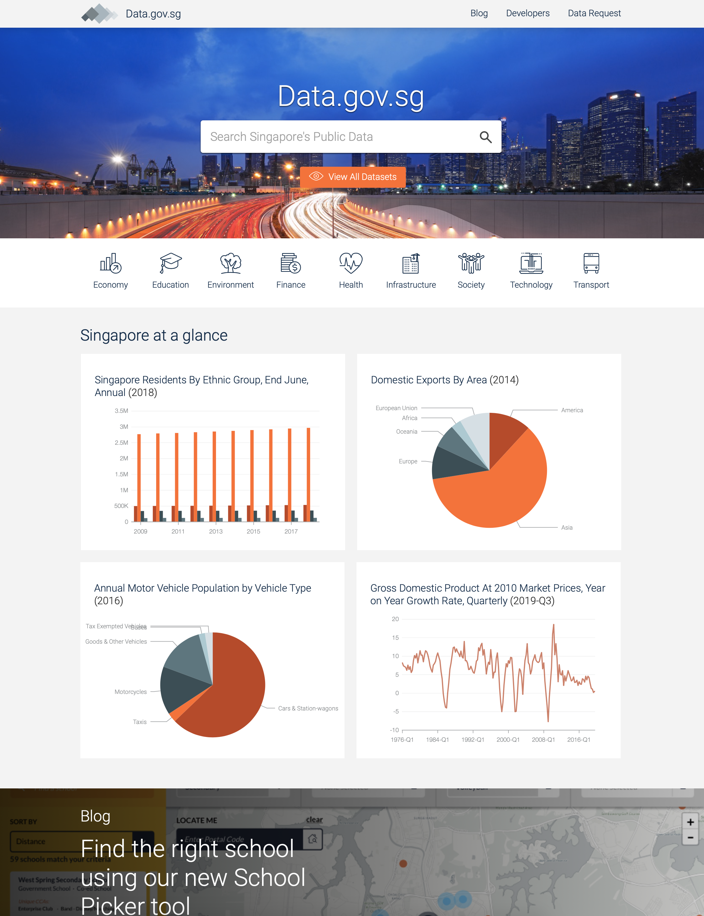
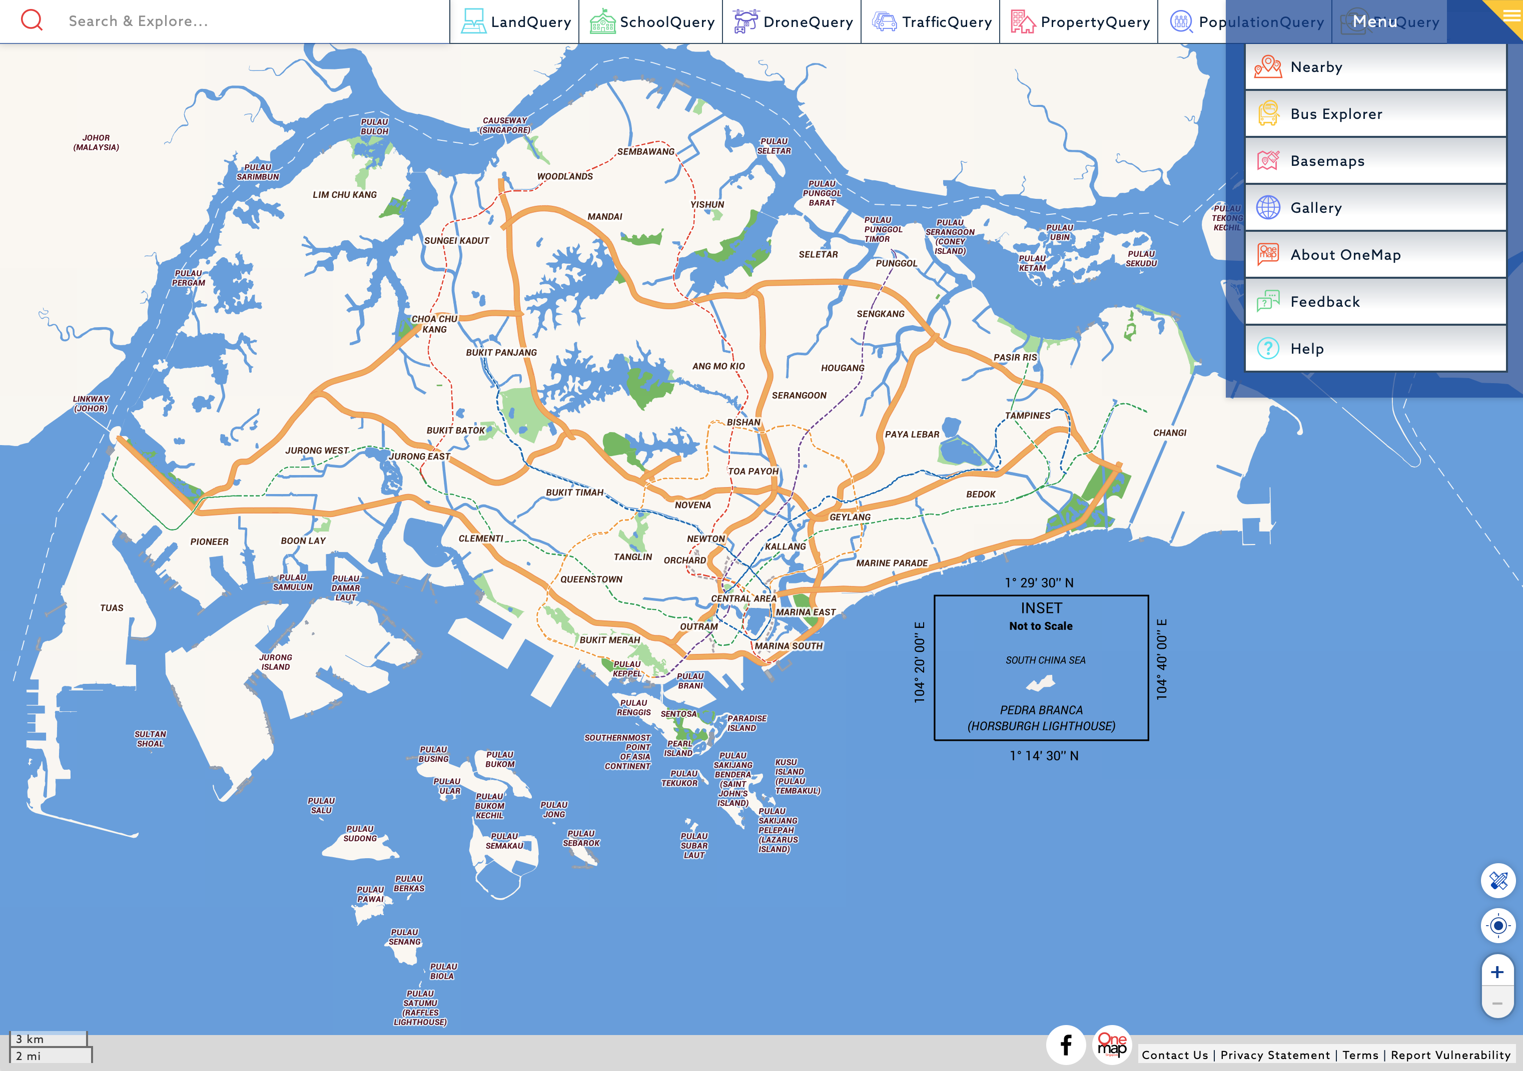
Data Visualisation
Overwhelming amount of data available today
A colour map is essentially millions of data points/ measurements. Overwhelming in an excel sheet, but easy to see on a map

Slide 7
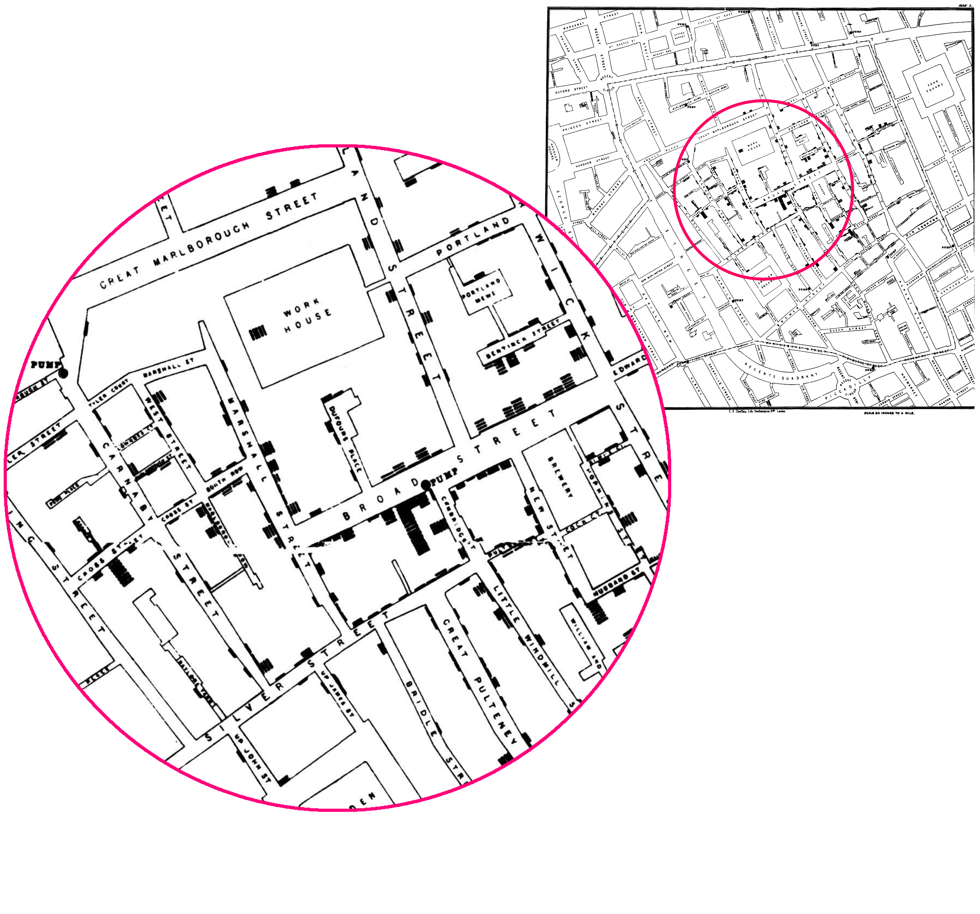
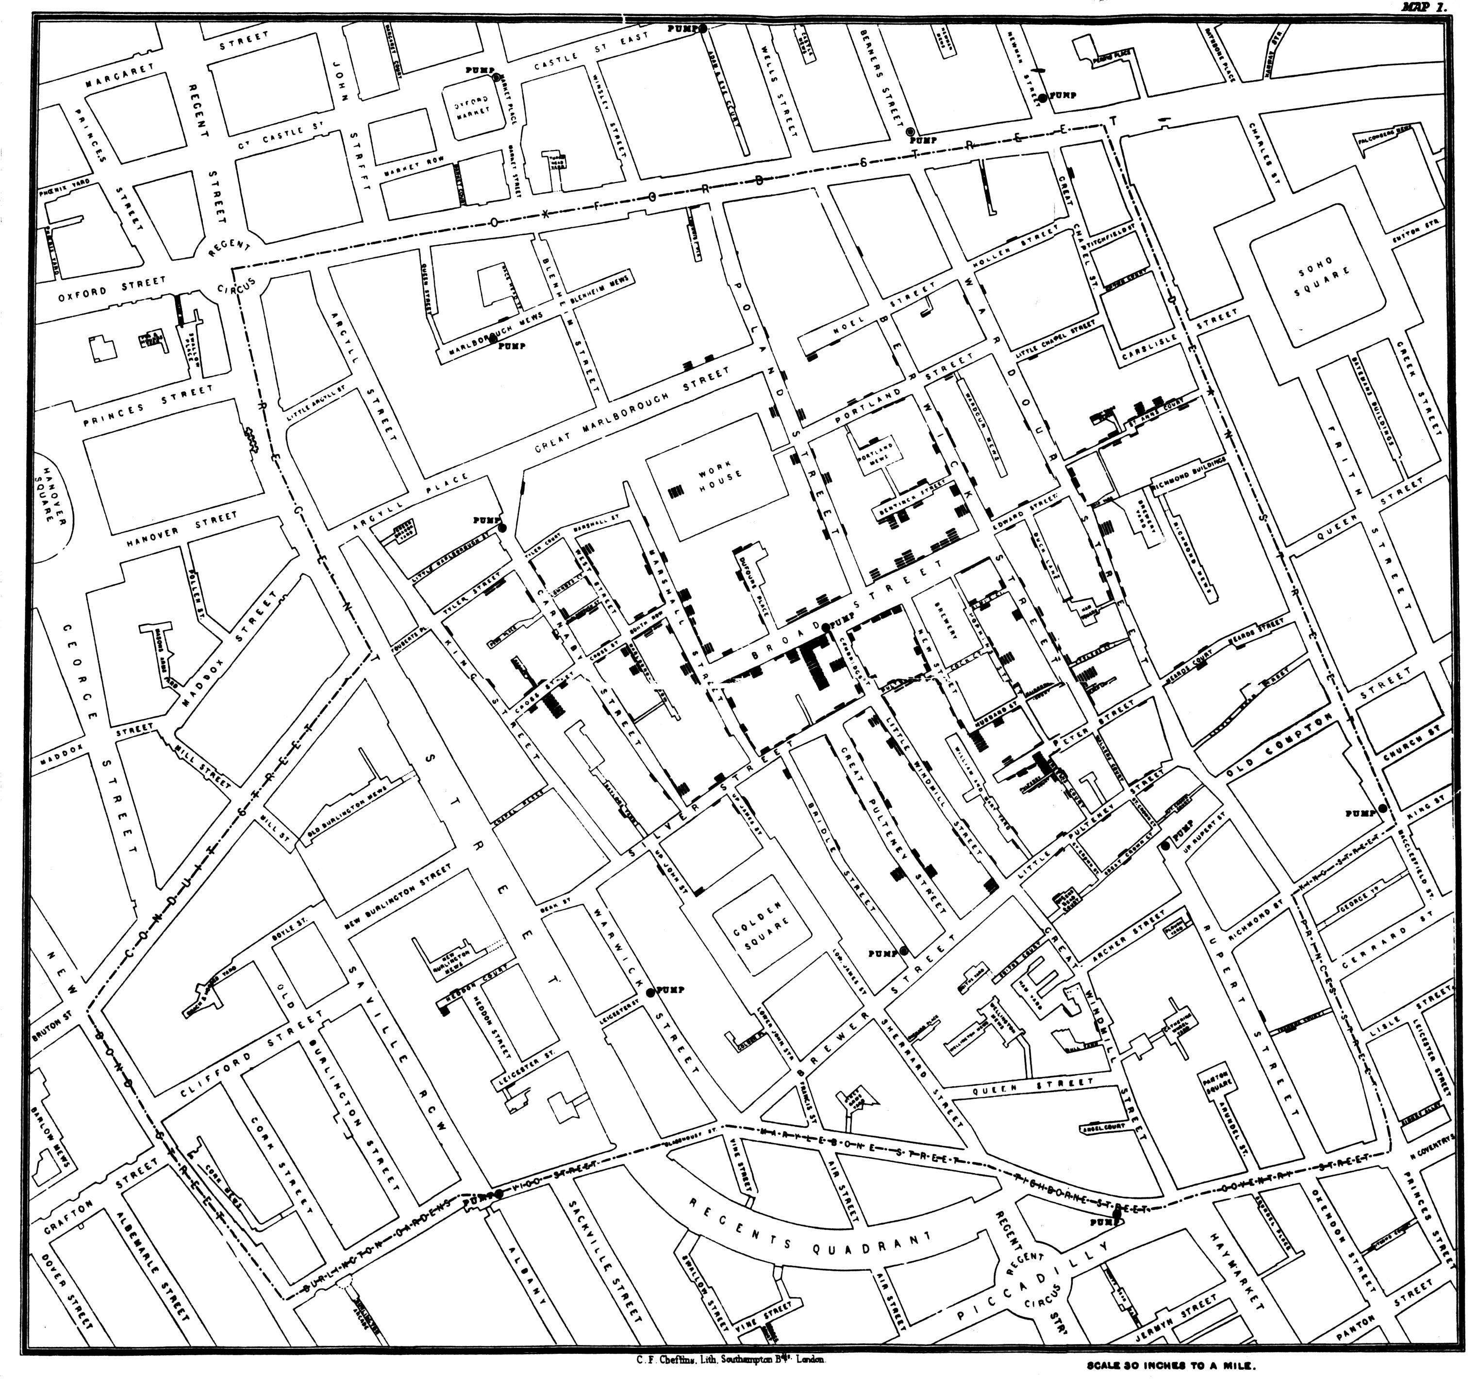
Data Visualisation
Pre-computing era visualisation
During the Cholera epidemic of 1849-1854 in London, John Snow showed a relationship between water wells and the severity of the outbreak amongst households
https://en.wikipedia.org/wiki/1854_Broad_Street_cholera_outbreak

Slide 8
Data Visualisation
Benefits
Provides us the ability to comprehend huge amounts of data
Allows the perception of emergent properties that are not anticipated (e.g. red for danger)
Often enable problems with data to become immediately apparent (missing data or blank (pixels))
Facilitates the understanding of both large-scale and small-scale features of the data
Facilitates hypothesis formation

Slide 9
Data Visualisation
The four stages of the data visualisation process [Ware (2013)]
Data Collection and Storage: the collection and storage of data
Data Pre-processing: the pre-processing of data to transform it into something one can understand
Graphics Engine: the display hardware and the graphics algorithms to produce data visualisation on screen
Human Visual and Cognitive Processing: human perceptual and cognitive systems that are involved in interpreting the visualised data

Slide 10
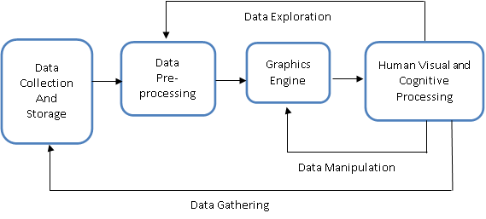
Data Visualisation
The four stages of the data visualisation process
Computational Processes → converting data to a usable format for the engine
Interactive and Interpretative → manipulation of the visual to gain understanding
Longest feedback loop; gather more data to probe interesting insight

Slide 11
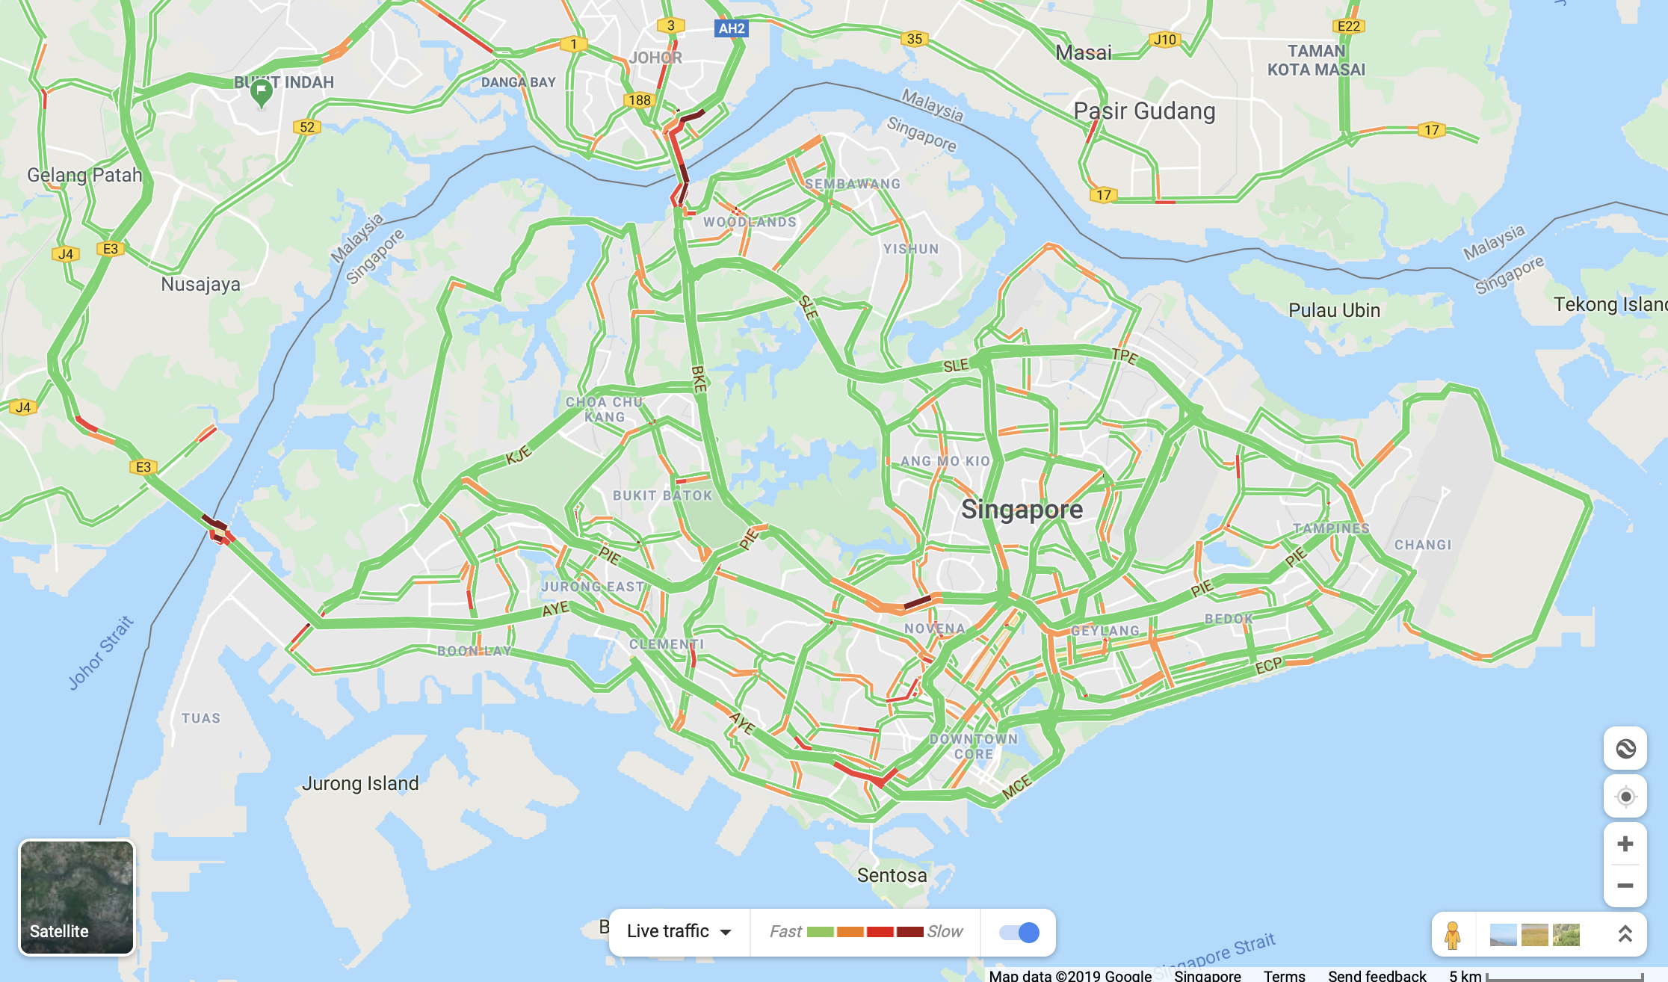
Data Visualisation
Data visualisation in everyday life
Google maps

Slide 12
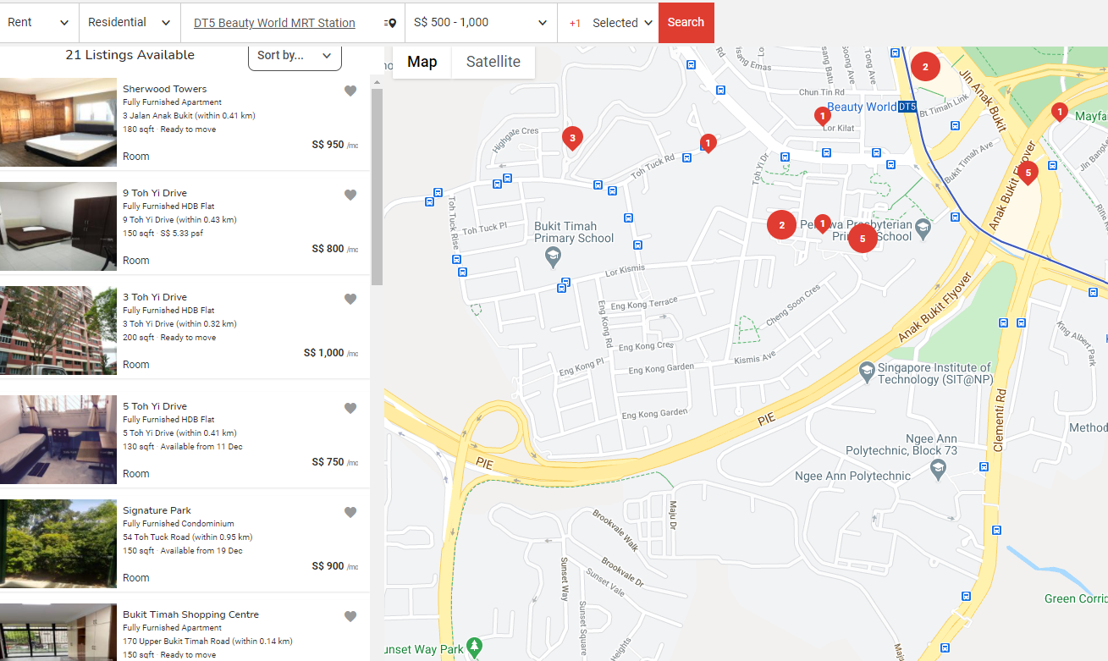
Data Visualisation
Data visualisation in everyday life
https://www.propertyguru.com.sg/map-search

Slide 13
Semiotics of Data Visualisation

Slide 14

Semiotics of Data Visualisation
The big idea – Concepts
Semiotics is the study of symbols and how they convey meaning
This discipline was originated in the United States by C. S. Peirce, and later developed in Europe by French philosopher and linguist Ferdinand de Saussure
Saussure defines a principle of arbitrariness, and applies it to the relationship between a symbol and the thing it signifies
Meanings to one culture may be nonsense to another, because society creates meaning
“Texas Longhorns”,
“Rock on”, Cheating Partner, “the devil”?

Slide 15

Semiotics of Data Visualisation
Properties of sensory and arbitrary representation
Sensory refers to symbols and aspects of representation that uses the perceptual processing power of the brain without training
Arbitrary refers to aspects of representation without a perceptual basis, and users must be trained to interpret it
Sensory representation can be understood without training, processed rapidly and in parallel, tends to be stable across individuals, cultures and time, and is resistant to instructional bias. Conversely, arbitrary representation is capable of rapid change and derives its power from culture. It can vary with culture and application
Pluviophile

Slide 16
Semiotics of Data Visualisation
Sensory vs arbitrary representation
Properties of Sensory Representation
Understanding without Training.
Resistance to Instructional Bias.
Sensory Immediacy.
Cross-cultural Validity.
Properties of Arbitrary Representation
Hard to Learn.
Easy to Forget.
Embedded in Culture and Applications.
Formally Powerful.
Capable of Rapid Change.
Circle or
Square
Read/ Write
Alphabets
Illusions
Colour Coding
Segmentation
Mathematics
Red Apple
Evolution of graphics
Data visualisation is a hybrid of the two
Notes:
Sensory Representation is effective, but sometimes misleading, because it is well matched to the early stages of neural processing. It tends to be stable across individuals, cultures and time. Conversely, Arbitrary Representation derives its power from culture, and it is therefore dependent on the particular cultural milieu of an individual.

Slide 17
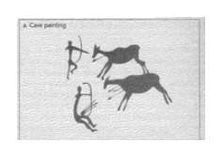
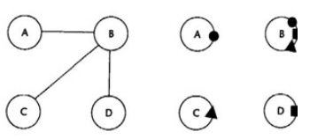

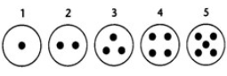
Class Discussion 1
Sensory or Arbitrary?
(a)
(b)
(c)
(d)

Slide 18
Class Discussion 1
Sensory or Arbitrary?
(a)
(b)
Arbitrary
Sensory
Arbitrary
Sensory
(c)
(d)

Slide 19
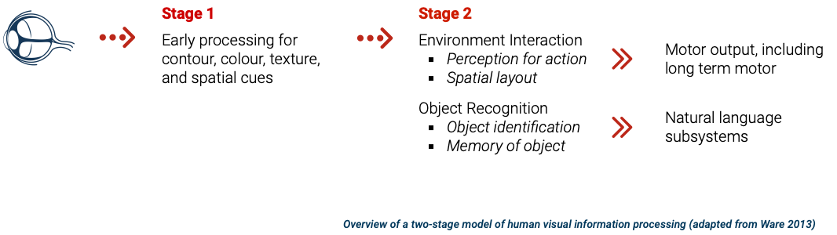
Semiotics of Data Visualisation
The perceptual processing model
Information is processed in parallel → understand information quickly
Information is processed sequentially
Notes:
Stage 2: Pattern Perception
At the second stage, rapid active processes divide the visual field into regions and simple patterns,
such as continuous contours, regions of the same color, and regions of the same texture.
Patterns of motion are also extremely important, although the use of motion as an information
code is relatively neglected in visualization. The pattern-finding stage of visual processing is
extremely flexible, influenced both by the massive amount of information available from Stage
1 parallel processing and by the top-down action of attention driven by visual queries. Marr
(1982) called this stage of processing the 2-112D sketch. Triesman (1985) called it a feature map.
Rensink (2002) called it a proto-object flux to emphasize its dynamic nature.
There is increasing evidence that tasks involving eye-hand coordination and locomotion may
be processed in pathways distinct from those involved in object recognition. This is the two-visual
system hypothesis: one system for locomotion and action, called the "action system," and another
for symbolic object manipulation, called the "what system." A detailed and convincing account
of it can be found in Milner and Goodale (1995).
Important characteristics of Stage 2 processing include:
Slow serial processing
Involvement of both working memory and long-term memory
More emphasis on arbitrary aspects of symbols
In a state of flux, a combination of bottom-up feature processing and top-down
attentional mechanisms
Different pathways for object recognition and visually guided motion
At the highest level of perception are the objects held in visual working memory by the demands
of active attention. In order to use an external visualization, we construct a sequence of visual
queries that are answered through visual search strategies. At this level, only a few objects can
be held at a time; they are constructed from the available patterns providing answers to the visual
queries. For example, if we use a road map to look for a route, the visual query will trigger a
search for connected red contours (representing major highways) between two visual symbols
(representing cities).
Beyond the visual processing stages shown in Figure 1.11 are interfaces to other subsystems.
The visual object identification process interfaces with the verbal linguistic subsystems of the
brain so that words can be connected to images. The perception-for-action subsystem interfaces
with the motor systems that control muscle movements.

Slide 20
Understanding Data

Slide 21
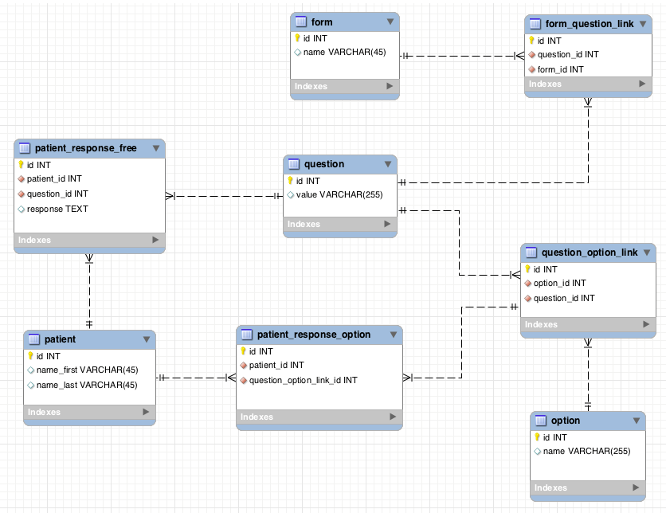
Understanding Data
The two fundamental forms of data – entities and relationships
Entities are generally objects of interest. A group of objects can be considered as a single entity by data visualisation designers
Relationships form the structures that relate to entities
Entity – Graphics card
Relationships – Graphics card as part of laptop
Source: http://i.stack.imgur.com/cMEOk.png

Slide 22
Understanding Data
Data attributes
Both entities and relationships can have attributes. In general, something should be called an attribute when it is a property of some entities and cannot be thought of independently (e.g. taste of a banana)
Defining what should be an entity and what should be an attribute is not always straight forward. For example, the price of a laptop could be thought of as an attribute of the laptop, but we can also think of that amount-of-money as an entity in itself. In this case we have to define the relationship between the laptop entity and the amount-of-money entity
Notes:
For example, the colour of a car is an attribute of the car, the taste of food is an attribute of the food, and the floor area is an attribute of a house.

Slide 23
Understanding Data
The four measurement levels of data quality attribute
Nominal measurements measure items based on their labels or categories or other qualitative classification the items belong to with no implied order
Ordinal measurements arise from the operation of rank ordering
Interval measurements allow us to measure the degree of difference between items, but not the ratio between them
Ratio measurements estimate the ratio between a magnitude of a continuous quantity and a unit magnitude of the same kind

Slide 24




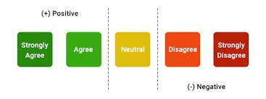



Understanding Types of Data
Types of Data
Qualitative
Quantitative
Arithmetic
Measuring the data
Nominal
Ordinal
Interval
Ratio
○K
Unordered
Ordered Words
Discrete
Continuous
No True Zero

Slide 25
Class Discussion 2
The four measurement levels of data quality attribute
What are some examples for the four levels of measurement that you can identify in your company, or any other organisations you are familiar with?
Notes:
Some possible answers include:
Nominal: Store type, department type
Ordinal: Preference ranking, market position, social class
Interval: Opinions, attitudes
Ratio: Age, sales, income, costs

Slide 26
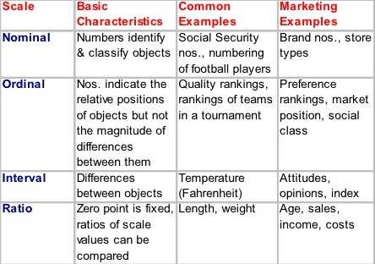
Class Discussion 2
The four measurement levels of data quality attribute
What are some examples for the four levels of measurement that you can identify in your company, or any other organisations you are familiar with?
Source: http://image.slidesharecdn.com/measurementandscales-120411075801-phpapp02/95/measurement-and-scales-6-728.jpg?cb=1334131308
Notes:
Some possible answers include:
Nominal: Store type, department type
Ordinal: Preference ranking, market position, social class
Interval: Opinions, attitudes
Ratio: Age, sales, income, costs

Slide 27
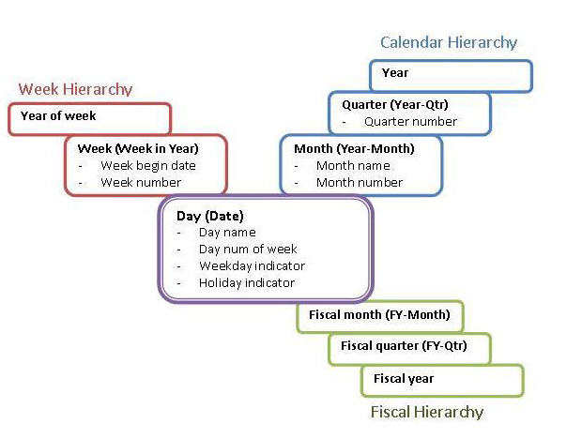
Understanding Data
Data Attributes Dimension
An attribute of an entity can have multiple dimensions.
Single scalar quantity, like the weight of a person, is a one dimension attribute.
Higher-order quantity, like tensor and gravitational field of the earth, are multiple dimensions attributes.
Source: http://i.cmpnet.com/intelligententerprise/images/0810/Data-Dimension-Hierarchies.jpg

Slide 28
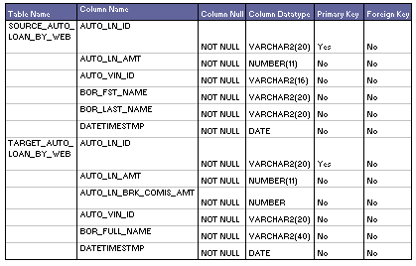
Understanding Data
Metadata
Metadata is structured information that explain, describe or locate the original (i.e. also known as primary data), otherwise make the using of original data more efficient
Source: http://learndatamodeling.com/wp-content/uploads/2015/10/tmeta.gif

Slide 29
Understanding Data
Data Dictionary
A data dictionary is a collection of descriptions of the data objects or items in a data model for the benefit of people who need to refer to them
An example: Data Dictionary for Customer
No. | Name | Description | Measurement | Data Type | Frequency
1 | USER_ID | ID of the customer | Nominal | ID | Monthly
2 | AGE | Age of the customer | Integer | Numeric | Monthly
3 | GENDER | Gender of the customer | Nominal | Character | Monthly
4 | SECTOR | The sector that the customer is working in | Nominal | Character | Monthly
7 | TOTAL_WEEKLY_SALES | Total purchases made by the customer in a week | Integer | Numeric | Weekly
8 | SALES_RANK_MTH | Ranking of customer based on the total purchases made by the customer in a month | Ordinal | Numeric | Monthly

Slide 30
Tableau (Class Activity)
(15 min break)

Slide 31

Tableau (Class Activity)
Sit in your GBA groups
Ensure that you have a working copy of Tableau Desktop installed on your computer
Ensure that you have the following datasets downloaded onto your computer:
global_superstore_2016.xlsx
Sales 2016.xlsx
Products 2016.csv
Coffee Chain.xlsx
Office City.xlsx
Time to power up Tableau!

Slide 32
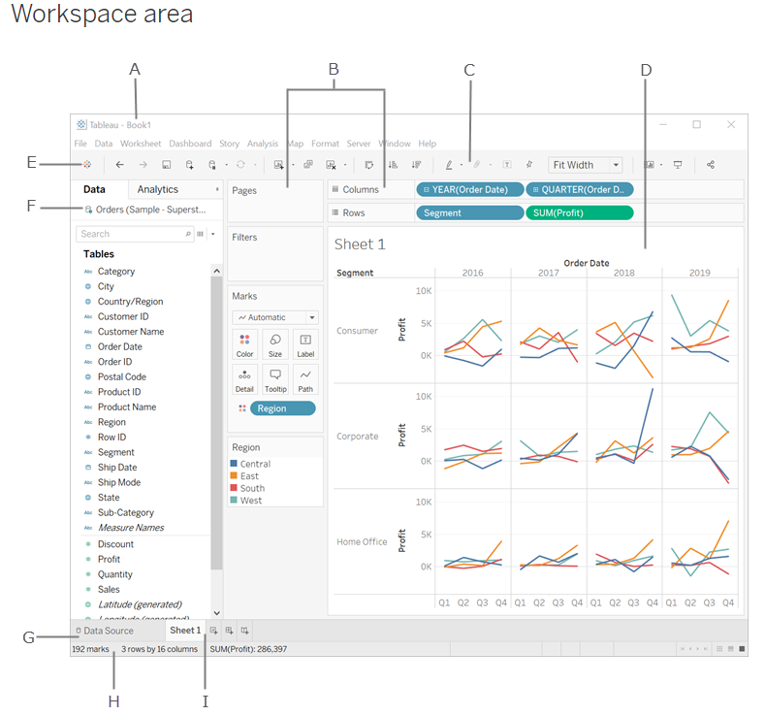
Tableau Interface
A. Workbook - contains sheets ( either a worksheet, dashboard, or story).
B. Cards and shelves - Drag fields to the cards and shelves in the workspace to add data to your view.
C. Toolbar - To access commands, analysis and navigation tools.
D. View - Workspace (Canvas) to create visualization ("viz").
E. Click this icon to go to the Start page to connect to data.
F. Side Bar - Contains the Data pane and the Analytics pane.
G. Data Source page - view and manipulate your data.
H. Status bar - Displays information about the current view.
I. Sheet tabs - Tabs represent each sheet (worksheets, dashboards, and stories) in your workbook.
https://help.tableau.com/current/pro/desktop/en-us/environment_workspace.htm
Notes:
Demonstrate how different tables can be joined, and illustrate the difference between inner, left, right and outer joins.

Slide 33
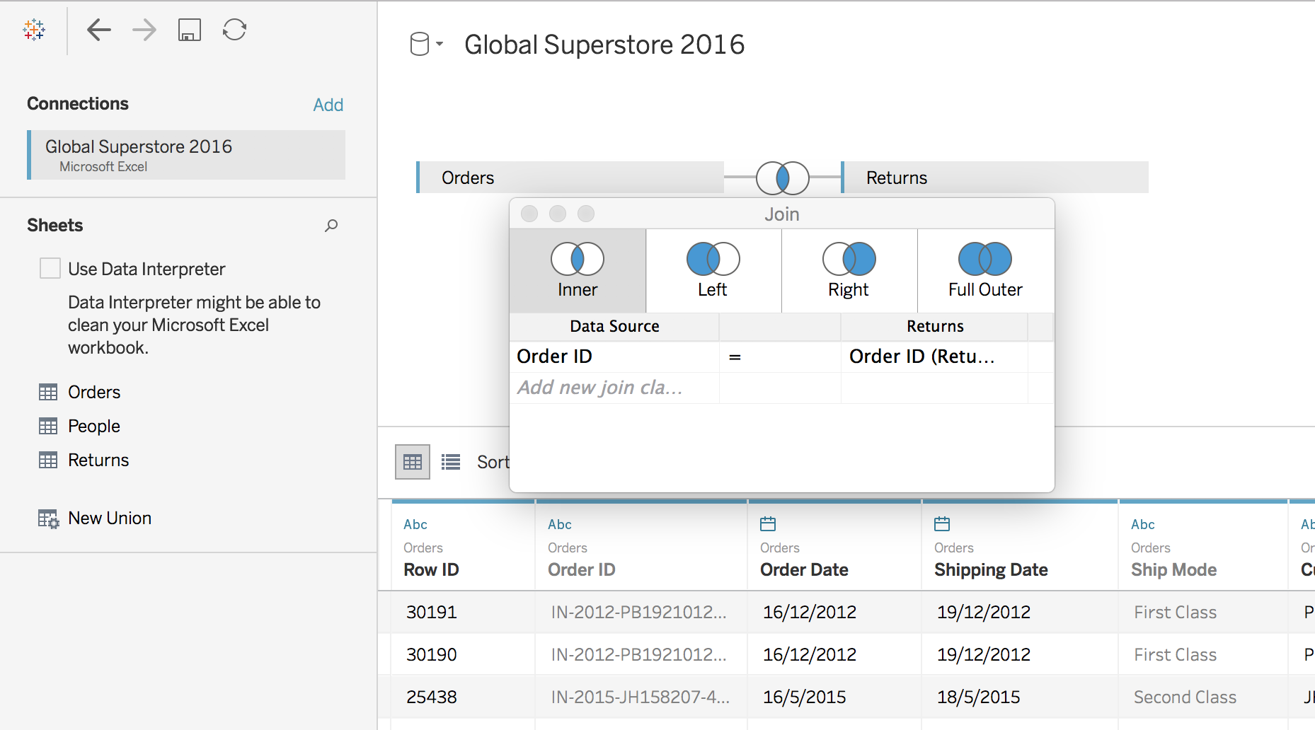
Table Join
Notes:
Demonstrate how different tables can be joined, and illustrate the difference between inner, left, right and outer joins.

Slide 34
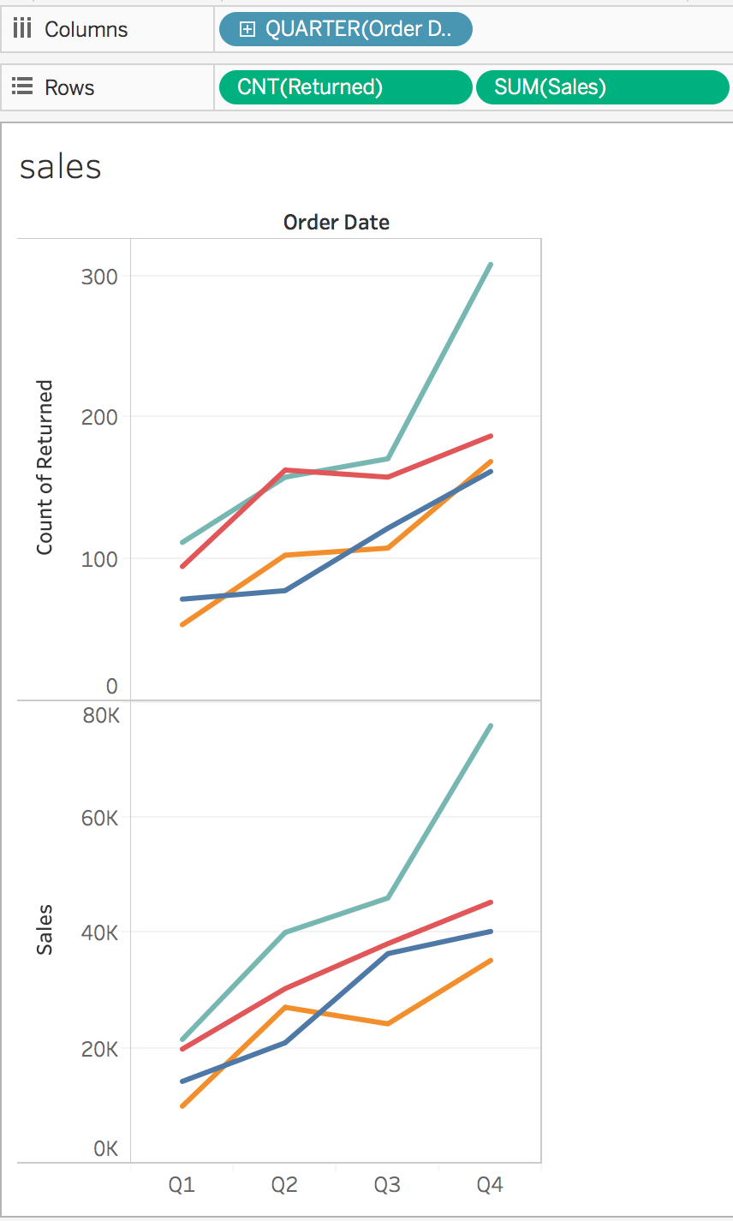
Table Join

Slide 35
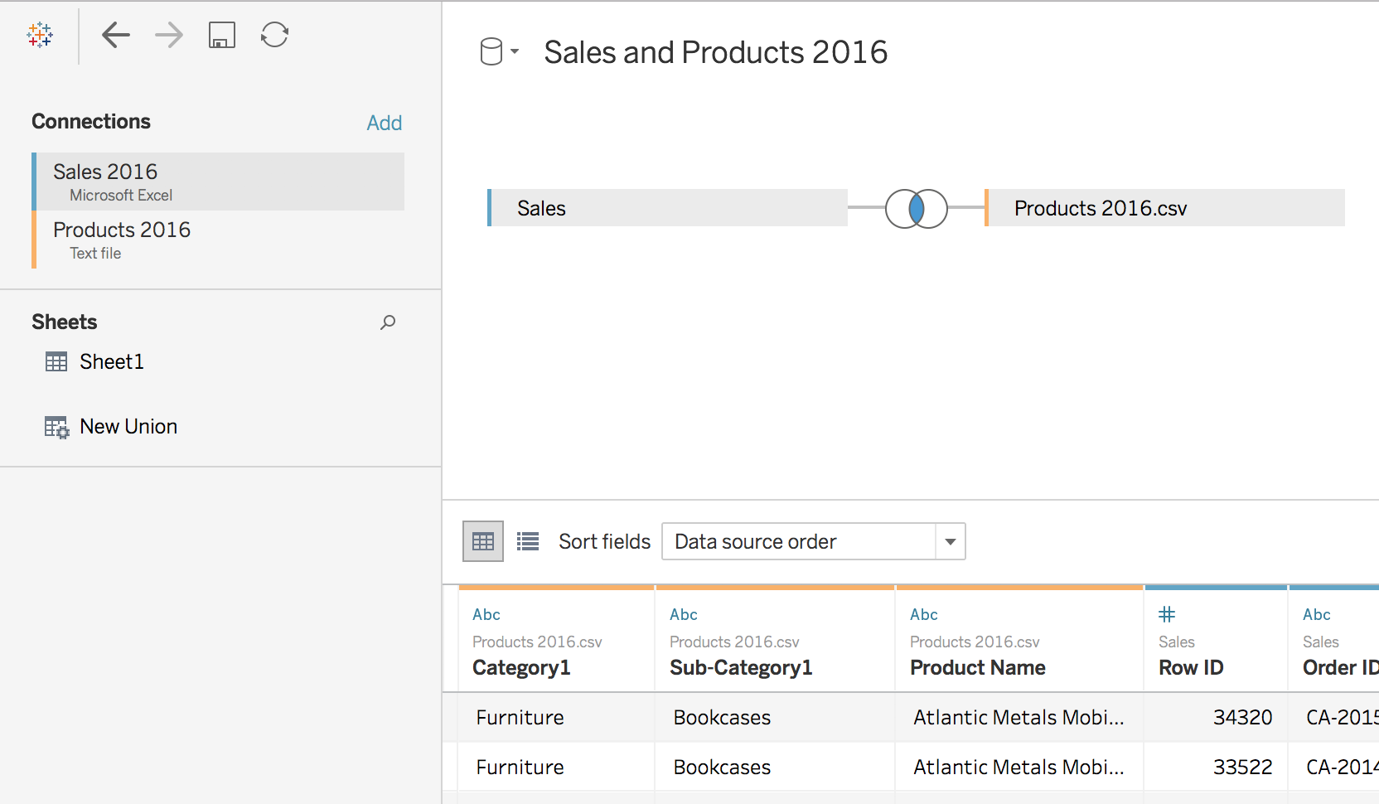
Cross-database Join
Notes:
Demonstrate join using different databases (Sales and Products 2016 data sets).

Slide 36
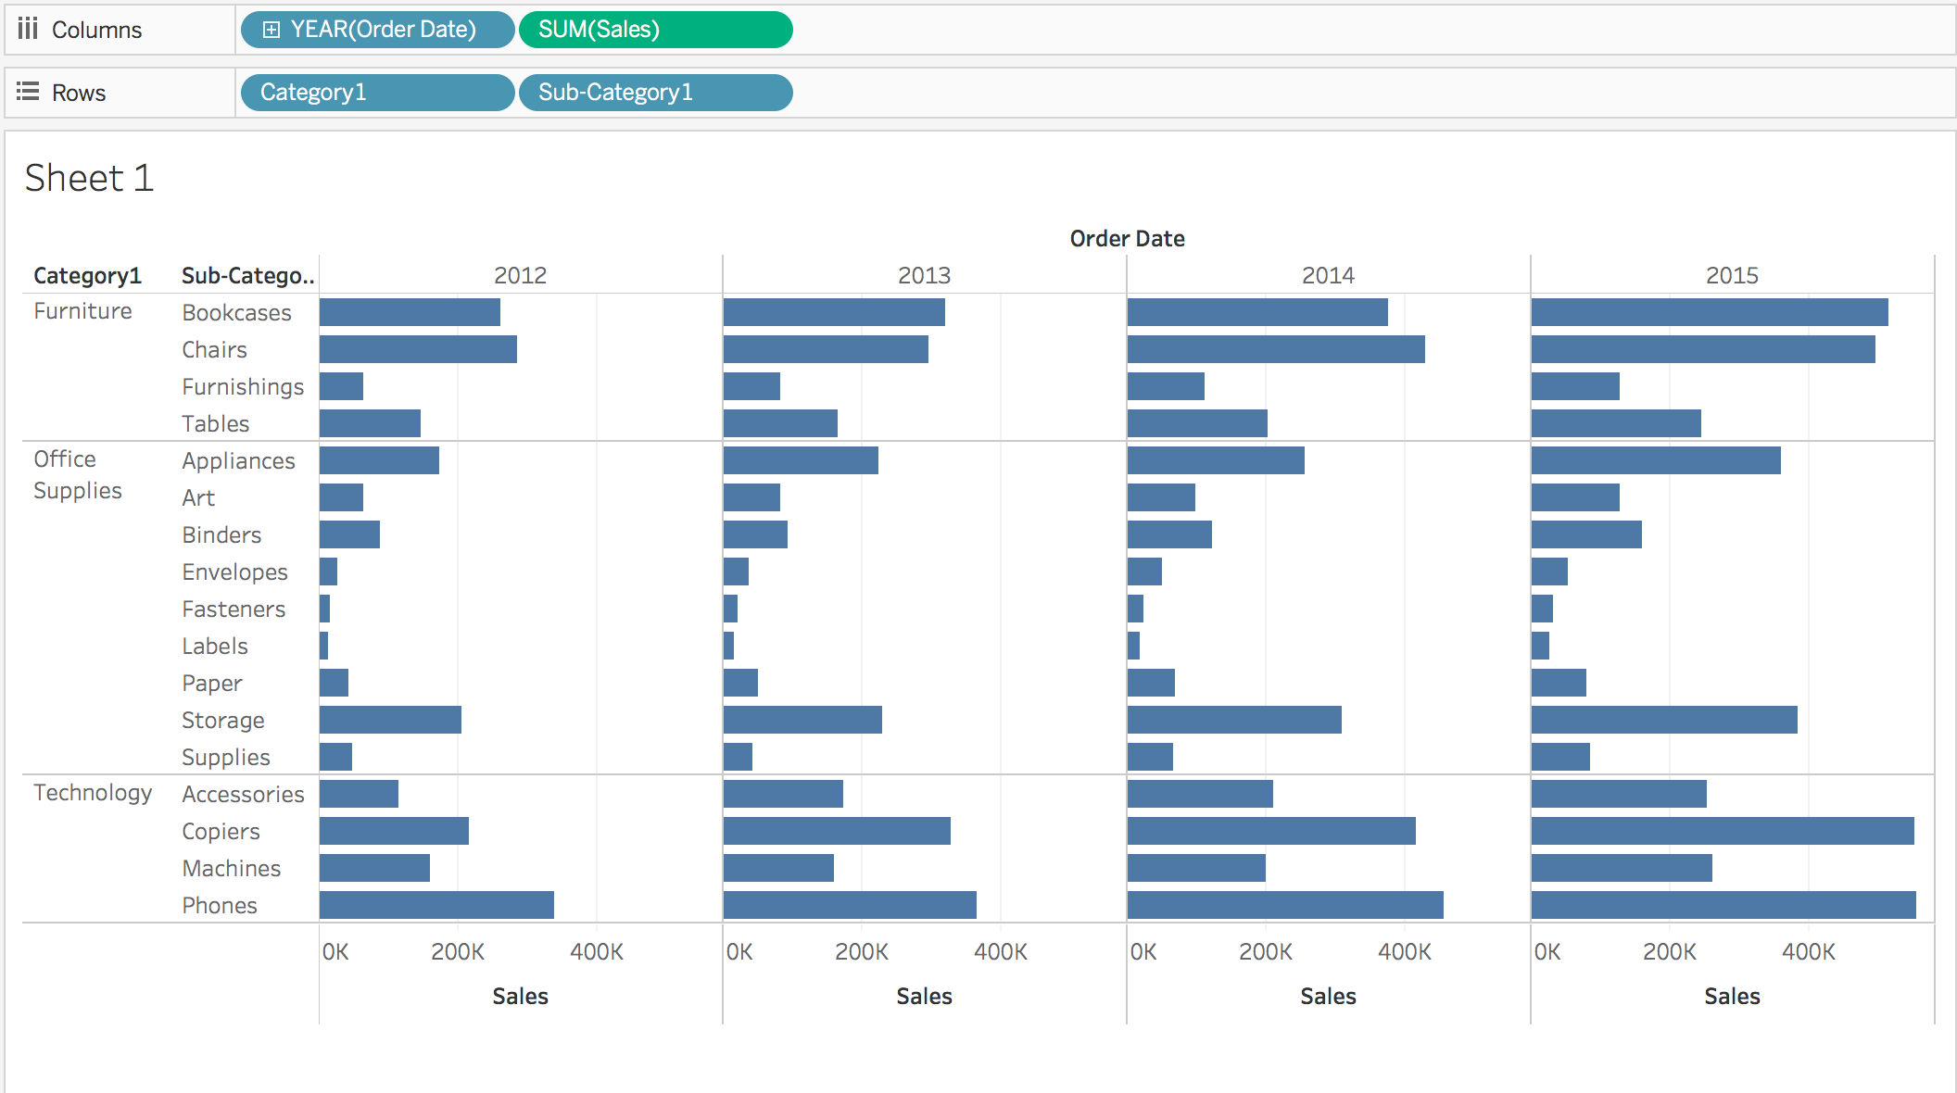
Cross-database Join

Slide 37
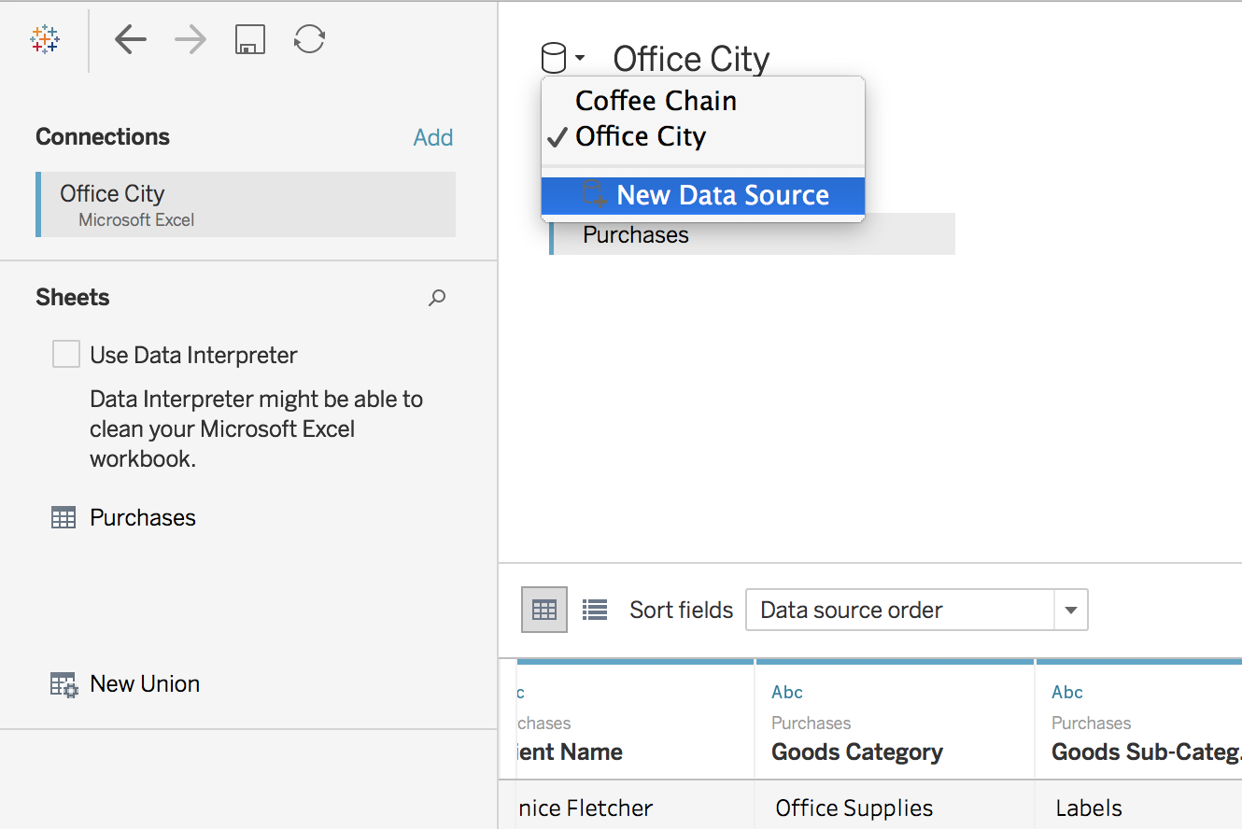
Data Blending
More info:
https://help.tableau.com/current/pro/desktop/en-us/multiple_connections.htm

Slide 38
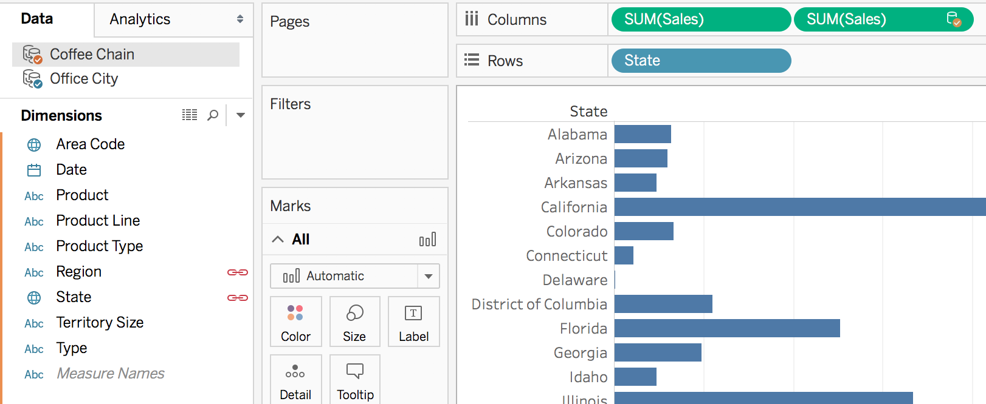
Data Blending
Discuss to identify:
Primary and Secondary data sources
linking field(s)
Notes:
Illustrate the difference between data blending and regular joins

Slide 39
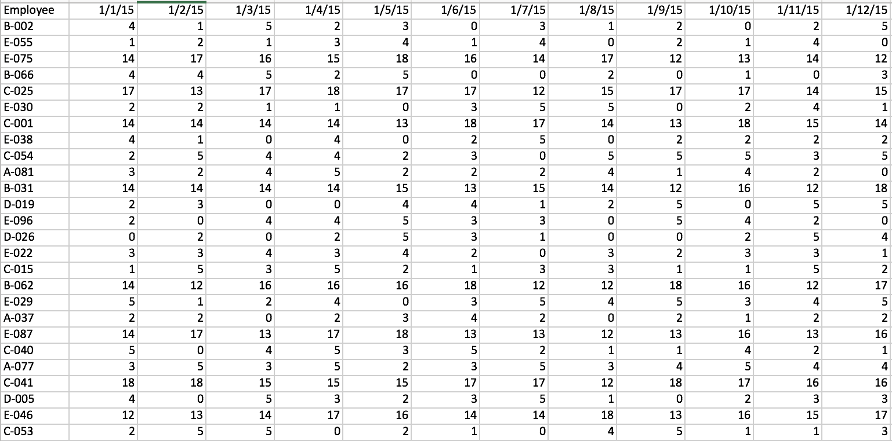
Pivot Data from Columns to Rows
Pivot from wide format to long format
More info:
https://help.tableau.com/current/pro/desktop/en-us/pivot.htm
Notes:
Make use of data_prep_flights.xlsx (resolved incidents) to demonstrate how a wide format can be pivoted to long format.

Slide 40
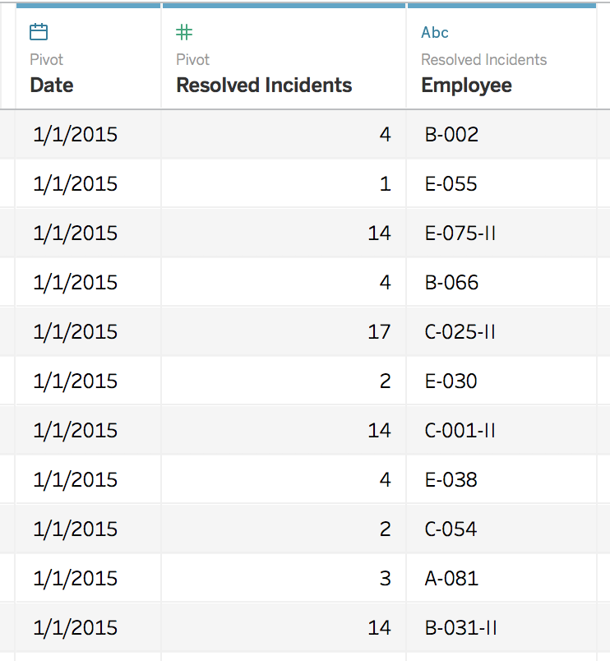
Pivot
To long format:
Notes:
highlight all the date columns and then click “pivot”

Slide 41
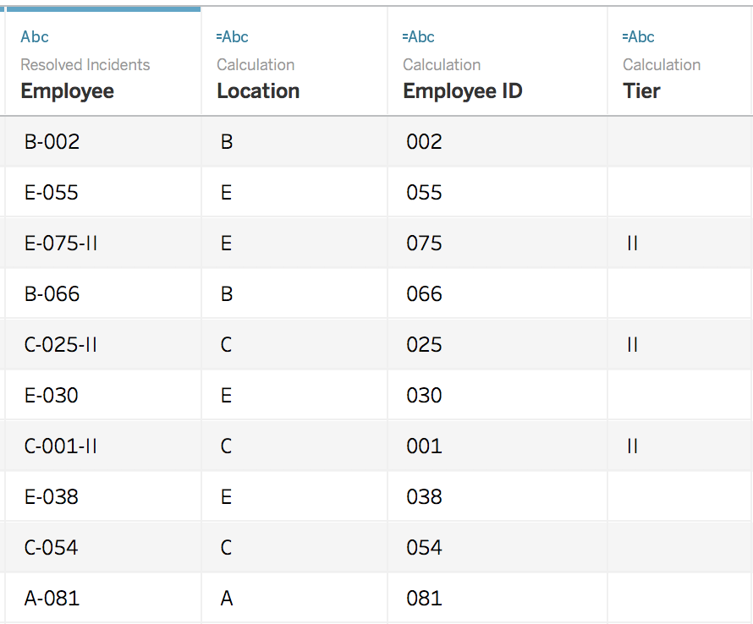
Split
Split “Employee” column:
Notes:
Click on Employee column and Split

Slide 42
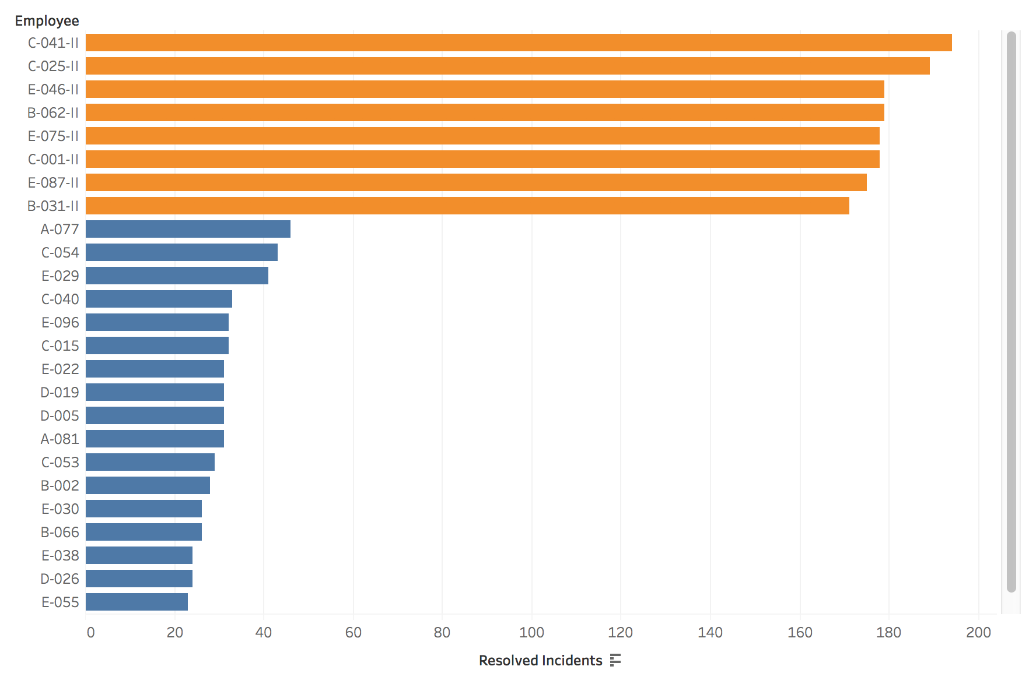
Split
Notes:
Use the generated column from split to create a chart.
Mouse in top middle bar graph to sort the bar graph by length of bars

Slide 43
Union vs Join
Union
Join
Month | Price | Quantity
Jan | 5 | 10
Month | Price | Quantity
Jan | 5 | 10
Month | Price | Quantity
Jan | 10 | 20
Month | Location
Jan | Bedok
Month | Price | Quantity
Jan | 5 | 10
Jan | 10 | 20
Month | Price | Quantity | Location
Jan | 5 | 10 | Bedok
Adding rows to existing data
Adding Columns to existing data

Slide 44
Join Types
Primary Table
Secondary Table
ID | Qty
A | 10
B | 20
C | 30
ID | Reg
A | East
C | West
D | North
Left
Right
Outer
Inner
ID | Qty | Reg
A | 10 | East
B | 20 | null
C | 30 | West
ID | Reg | Qty
A | East | 10
C | West | 30
D | North | null
ID | Qty | Reg
A | 10 | East
B | 20 | null
C | 30 | West
D | null | North
ID | Qty | Reg
A | 10 | East
C | 30 | West
Primary = “Master”
Secondary = “Slave”
Primary = “Slave”
Secondary = “Master”
Equivalent to
Logical “OR”
Equivalent to
Logical “AND”

Slide 45
Pivot Data – Data Source Grouping
Year | Age Group | Population
1959 | 0-4 | 100
1960 | 0-4 | 400
1961 | 0-4 | 700
1959 | 5-9 | 200
1960 | 5-9 | 0
1961 | 5-9 | 100
1959 | 10-14 | 300
1960 | 10-14 | 500
1961 | 10-14 | 200
Year | 0-4 | 5-9 | 10-14
1959 | 100 | 200 | 300
1960 | 400 | 0 | 500
1961 | 700 | 100 | 200
Pivoting reduces the number of columns, and increases the number of rows
However, by grouping data, the data structure and usability improves significantly.
Caveats:
Same Datasource
Same Connection
Excel, Textfile, Google Sheets, .pdf

Slide 46
Relationships & Data Blending
Primary Table
Secondary Table
ID | Qty
A | 10
B | 20
ID | Reg
A | East
B | West
Single Data Source
JOIN
ID | Qty
A | 10
B | 20
Data Source 1
RELATIONSHIP
Only Dimensions, not Measures
ID | Reg
A | East
B | West
Data Source 2

Slide 47
Building Blocks & Syntax – Data Source Manipulation using Calculated Fields
Roll | Student | Grade
1 | Ali | 80
2 | Benny | 40
3 | Carrie | 60
4 | Daffy | 50
Calculated
PAS
FAIL
PASS
FAIL
IF [GRADE] > 50 THEN “PASS“
ELSE “FAIL“
END
Functions
Fields
Operators
Literal Expressions
Number ABS(-3) = 3
[GRADE]
>
“PASS”
Strings Len(“Ali”) = 3
Type Conversion INT(50.1) = 50
Logical IF [Ali] THEN “Pass”
https://help.tableau.com/current/pro/desktop/en-us/functions.htm

Slide 48
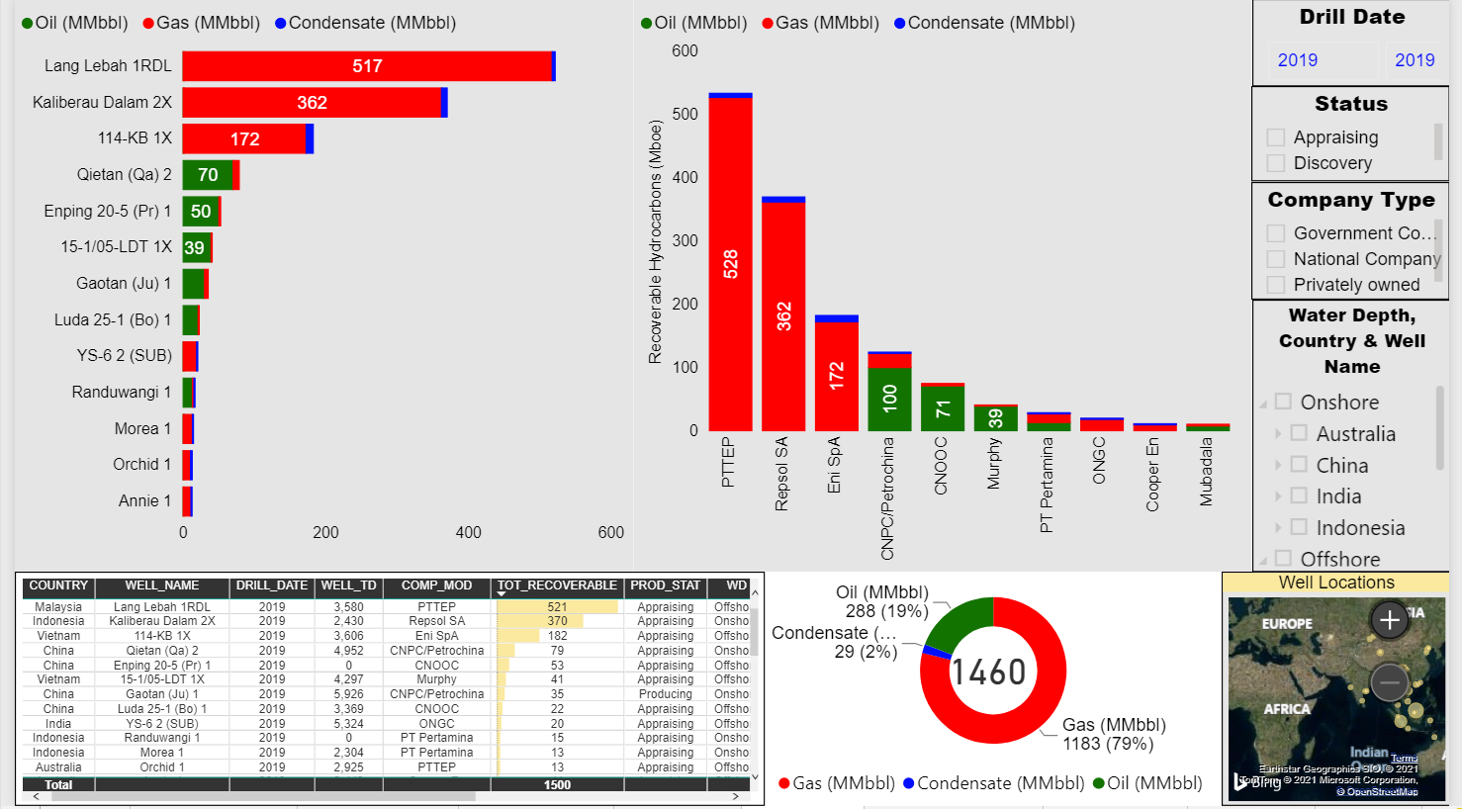
Power BI Demo
Notes:
Click on Employee column and Split

Slide 49
Course Homepage | https://canvas.suss.edu.sg/courses/31564
Study Guide | https://ibookstore.suss.edu.sg/
Tableau Desktop | https://www.tableau.com/products/trial
Tableau Tutorials | https://www.tableau.com/learn/get-started/creator
Academic Calendar | https://www.suss.edu.sg/docs/default-source/contentdoc/oas/pt-2021acadcalendar.pdf

Slide 50
Tableau Desktop System Requirements
Windows
Windows 7 or newer (64 bit)
Intel Pentium 4 or AMD Opteron processor or faster
2 GB memory
1.5 GB minimum free disk space
Mac
iMac/MacBook computers 2009 or newer
macOS High Sierra 10.13 and macOS Mojave 10.14
1.5 GB minimum free disk space
Notes:
Get licenses for students at https://www.tableau.com/academic/teaching/course-licenses

Slide 51
Tableau Prep Builder System Requirements
Windows
Windows 7 or newer (64 bit)
Intel Core i3 or AMD Ryzen 3 Pro or faster
4 GB memory
2 GB minimum free disk space
Mac
macOS High Sierra 10.13 and macOS Mojave 10.14
Intel Core i3 or faster
4 GB memory
2 GB minimum free disk space

